Slide 1

Project Inception Toronto Business Clustering
04/10/2021

Slide 2
Business Problem
Target Audience
New Business Owners in the Toronto area
Problem
New Toronto Business Owners are having a difficult time locating the best neighborhood/area in which to place their Businesses when compared to other Businesses in the areas, in order to increase their customers as much as possible.
Solution Goal
Brings to light the best neighborhood in Toronto to place their Businesses using clustering to find the top ten current Business types in those neighborhoods. With this knowledge Business Owners can make the best-informed decision to increase their chances of success.

Slide 3
Data To Be Used
FourSquare API
This data source will bring in all the businesses within Toronto neighborhoods for our clustering methods to gather the top ten Businesses form each neighborhood.
Geolocation Data
This data source will allow us to find the coordinates of each Toronto neighborhood for us to match the Business data within the FourSquare API.

Slide 4
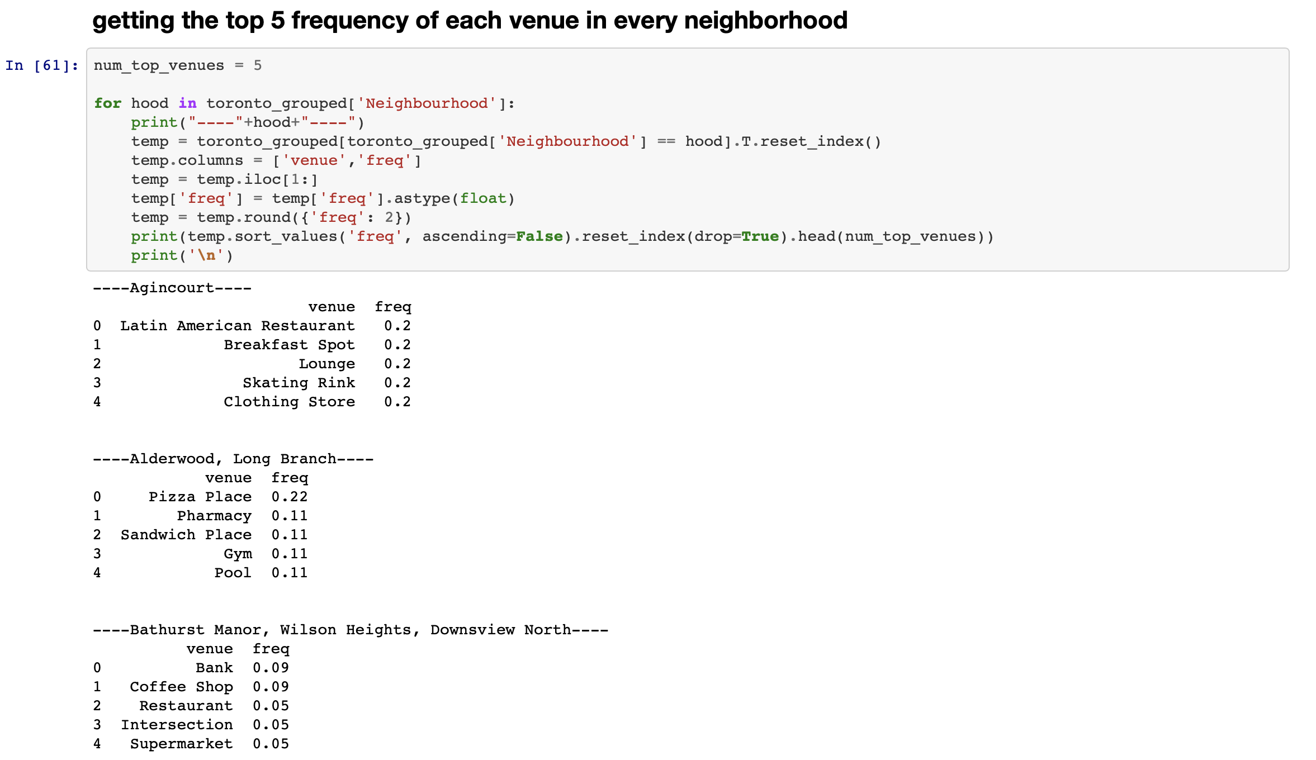
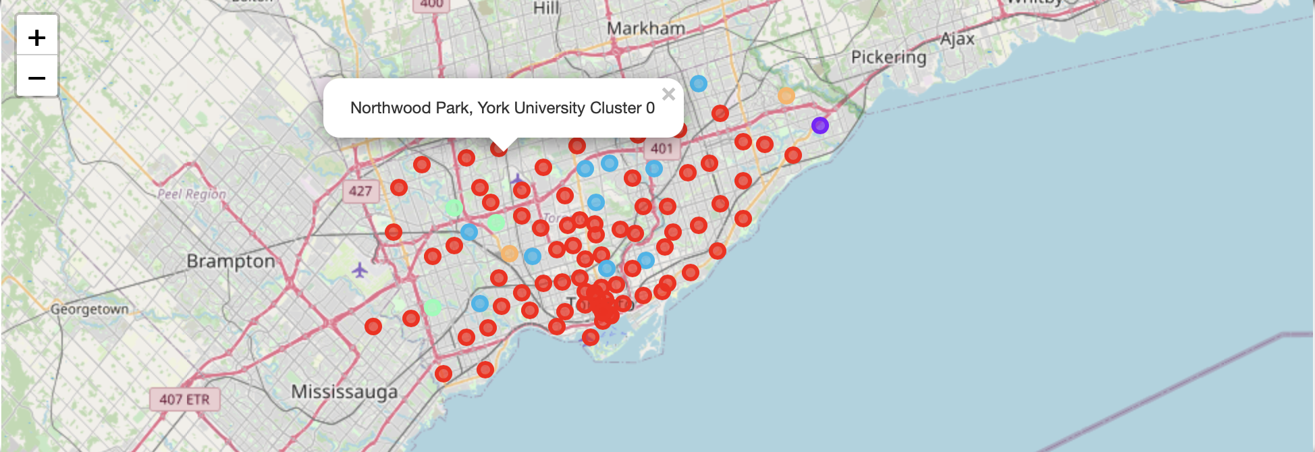
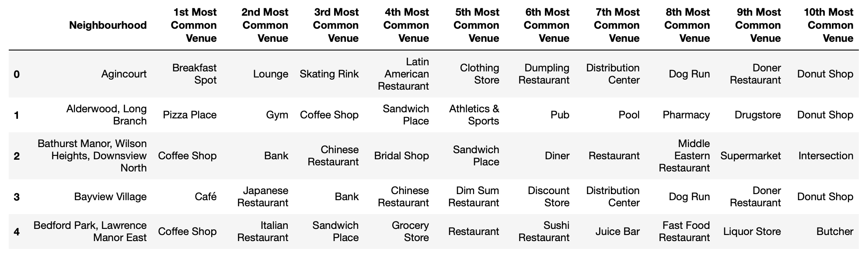
Methodology
Exploratory Data Analysis
Ensured that there were no neighborhoods without a name
Removed any duplicated postal-codes for accuracy
Did a quick analysis on the first postal-code to ensure the FourSquare API Data was being retrieved correctly
Statistical Testing
Grabbed the top 5 frequent Business Types per neighborhood. This was done to get a quick glimpse at the top Businesses in each neighborhood by %
Machine Learning Algorithm
I used a K-Means clustering method in order to cluster the neighborhoods with the most similar primary Business Types based on their top ten Businesses.

Slide 5
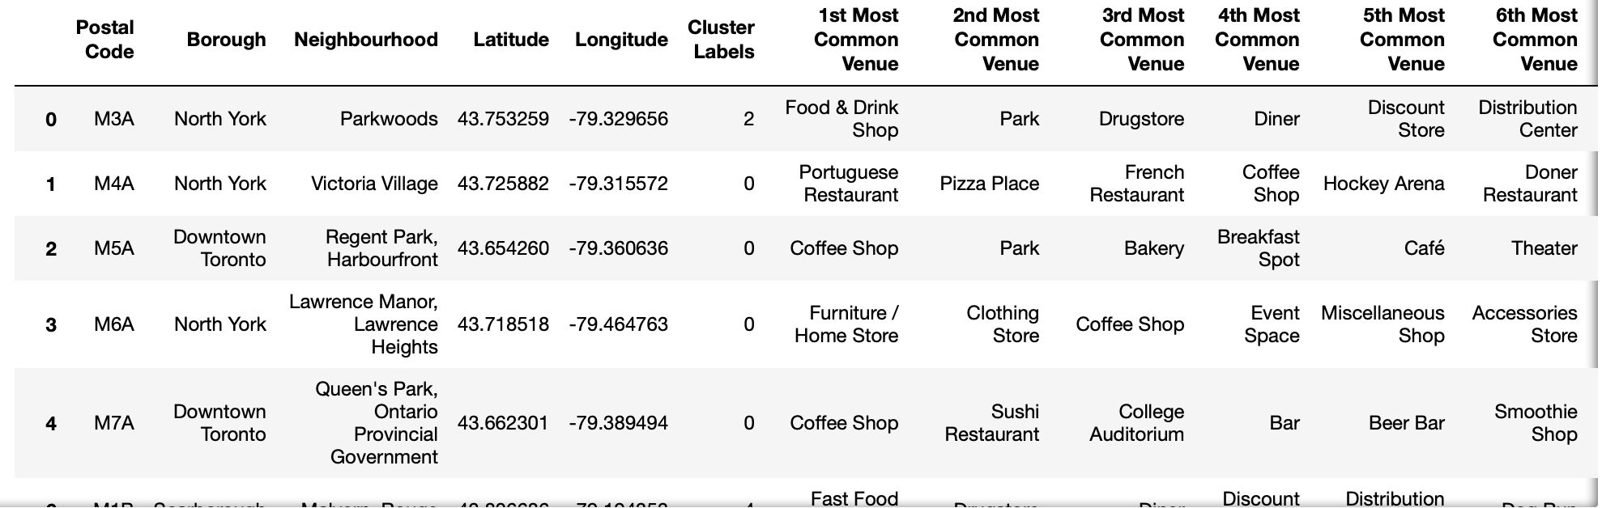
Results
Final Dataset Explanation
Our final dataset used for our plotting was neighborhood, coordinates, cluster number, and top ten Business type based
Each neighborhood was assigned a cluster number based on their top ten Business types.
Clustering Explanation
Five clusters seemed to be the best suited number of clusters in order to get the most accurate grouping by similarity.

Slide 6
Observations Made
Clusters at a high-level
First Cluster was primarily urban/suburban areas with a lot of diversity in Businesses
Second Cluster seemed to be possibly more rural areas with not many restaurants or activities but were primarily stores.
Third Cluster was rural areas with a lot of outdoor activities and local stores
Fourth Cluster were smaller towns with a focus on yoga and bakeries
Fifth Cluster were small towns with mainly fast-food options

Slide 7
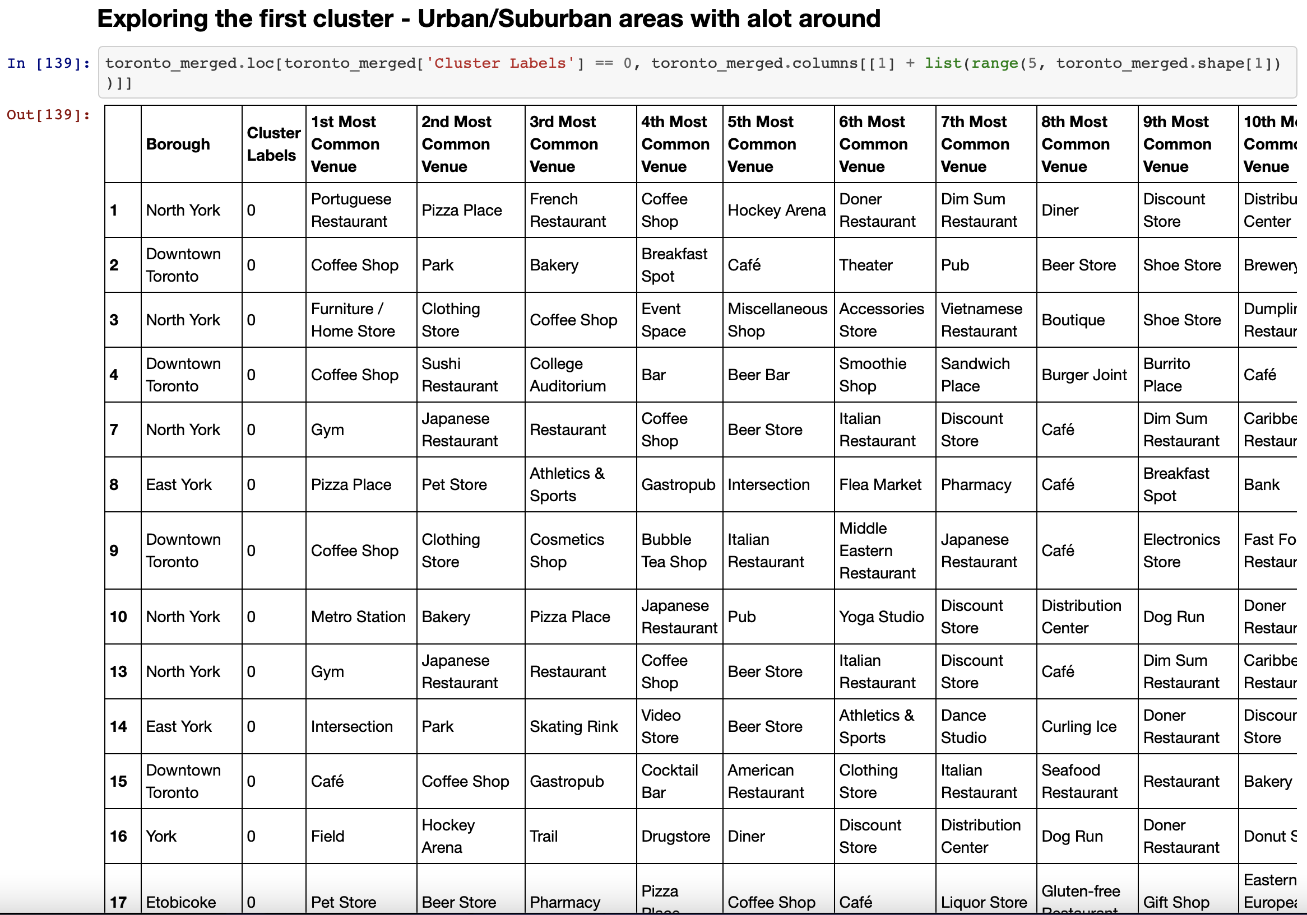
First Cluster
As seen in the image the Business diversity is extreme in these neighborhoods. This leads me to believe that if a new Business Owner is targeting this area they will have extreme competition among many Business types.

Slide 8
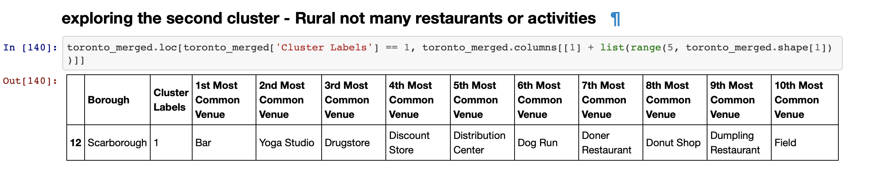
Second Cluster
As seen in this image there is only one neighborhood listed and aren’t many restaurants in the area. This leads me to believe that if one is looking to open a restaurant or a store of some kind, they could have a high chance of success.

Slide 9
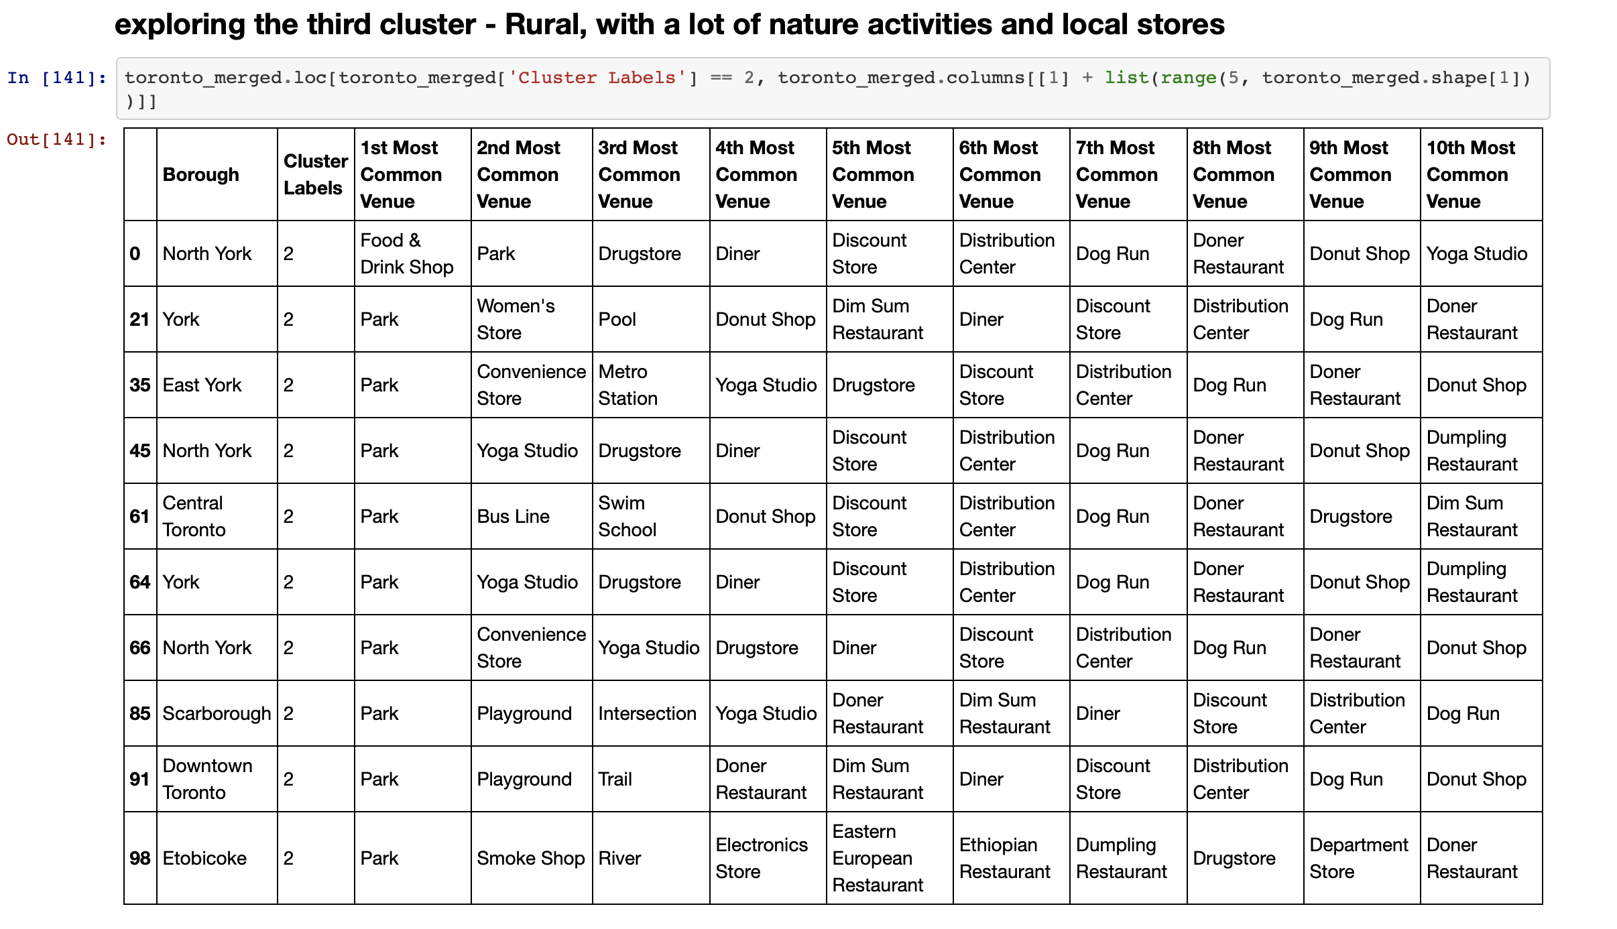
Third Cluster
As seen in the image these areas have many nature activities around them and local stores as well. This leads me to believe that if one is looking to open a restaurant, or indoor activity they could possibly have a high chance of success. Whereas if one looks to open a nature activity or lovoal shop there wil be many competitors.

Slide 10
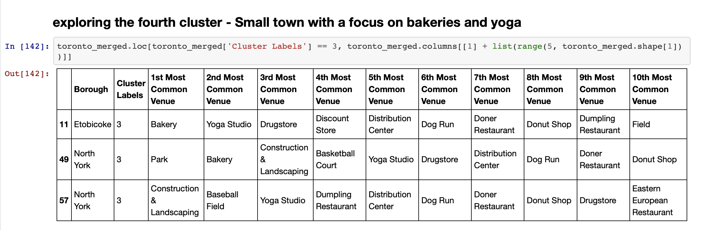
Fourth Cluster
As seen in the image these areas have many bakeries and yoga studios as their top 2 most common businesses. This leads me to believe that if one is looking to open a yoga or bakery studio there will be many competitors. They may have better odds with a fast food option or many an outdoor activity center.

Slide 11
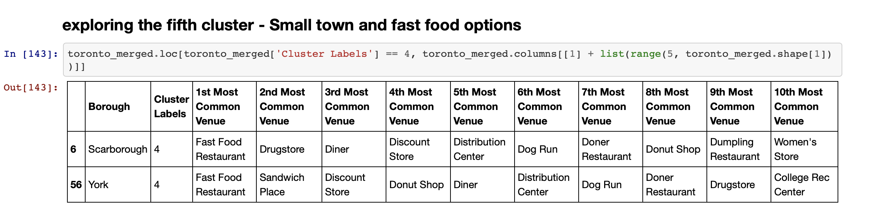
Fifth Cluster
As seen in the image these areas have many fast food and drugstore options. This leads me to believe that if one opens a restaurant or outdoor/indoor activity center they may have a better chance of success.

Slide 12

Conclusion
This concludes the Clustering Project for new Business Owners where they can now use live FourSquare API data with coordinates data in order to find a neighborhood that may better suite their business chances of success.
This could lead to huge success for new Businesses who are looking to open in unfamiliar areas to them.

